Slide 1
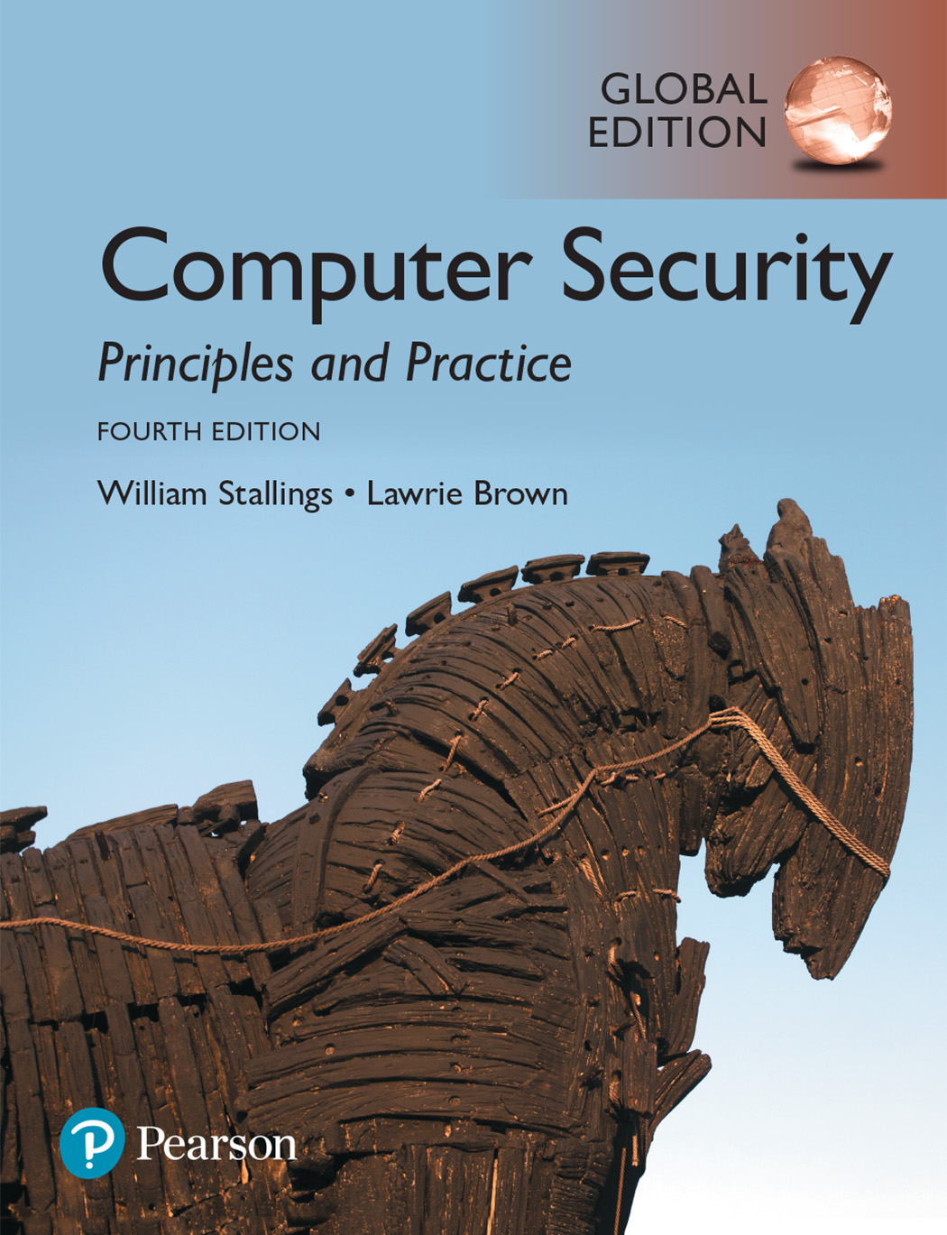

Slide 2
Chapter 4
Access Control

Slide 3
Access Control Definition
RFC 4949 defines access control as:
“a process by which use of system resources is regulated according to a security policy and is permitted only by authorized entities (users, programs, processes, or other systems) according to that policy”
Notes:
2. RFC 4949, Internet Security Glossary , defines access control as a process by
which use of system resources is regulated according to a security policy and
is permitted only by authorized entities (users, programs, processes, or other
systems) according to that policy.

Slide 4
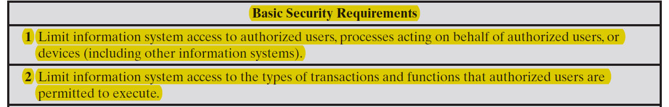
Table 4.1
Access Control Security Requirements ( SP 800-171)
Notes:
Table 4.1, from NIST SP 800-171 (Protecting Controlled Unclassified Information
in Nonfederal Information Systems and Organizations , August 2016), provides
a useful list of security requirements for access control services.

Slide 5
Access Control Principles
In a broad sense, all of computer security is concerned with access control
RFC 4949 defines computer security as:
“measures that implement and assure security services in a computer system, particularly those that assure access control service”
Notes:
In a broad sense, all of computer security is concerned with access control. Indeed,
RFC 4949 defines computer security as follows: measures that implement and assure
security services in a computer system, particularly those that assure access control
service. This chapter deals with a narrower, more specific concept of access control:
Access control implements a security policy that specifies who or what (e.g., in the
case of a process) may have access to each specific system resource, and the type of
access that is permitted in each instance.

Slide 6
Access Control Context
In addition to access control, this context involves the following entities and functions:
Authentication: Verification that the credentials of a user or other system entity are valid.
Authorization: The granting of a right or permission to a system entity to access a system resource. This function determines who is trusted for a given purpose.
Audit: An independent review and examination of system records and activities in order to test for adequacy of system controls, to ensure compliance with established policy and operational procedures, to detect breaches in security, and to recommend any indicated changes in control, policy, and procedures.
An access control mechanism mediates between a user (or a process executing on behalf of a user) and system resources, such as applications, operating systems, firewalls, routers, files, and databases.
The system must first authenticate an entity seeking access. Typically, the authentication function determines whether the user is permitted to access the system at all. Then the access control function determines if the specific requested access by this user is permitted.

Slide 7
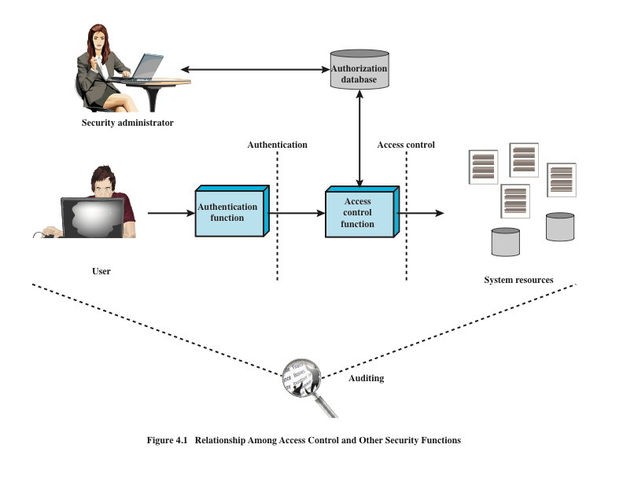
Source: Based on [SAND94].
Source: Based on [SAND94].
Notes:
Figure 4.1 shows a broader context of access control. In addition to access
control, this context involves the following entities and functions:
• Authentication: Verification that the credentials of a user or other system
entity are valid.
Authorization: The granting of a right or permission to a system entity to
access a system resource. This function determines who is trusted for a given
purpose.
• Audit: An independent review and examination of system records and activities
in order to test for adequacy of system controls, to ensure compliance with
established policy and operational procedures, to detect breaches in security,
and to recommend any indicated changes in control, policy and procedures.
An access control mechanism mediates between a user (or a process executing
on behalf of a user) and system resources, such as applications, operating systems,
firewalls, routers, files, and databases. The system must first authenticate an entity
seeking access. Typically, the authentication function determines whether the user
is permitted to access the system at all. Then the access control function determines
if the specific requested access by this user is permitted. A security administrator
maintains an authorization database that specifies what type of access to which
resources is allowed for this user. The access control function consults this database
to determine whether to grant access. An auditing function monitors and keeps a
record of user accesses to system resources.
In the simple model of Figure 4.1, the access control function is shown as
a single logical module. In practice, a number of components may cooperatively
share the access control function. All operating systems have at least a rudimentary,
and in many cases a quite robust, access control component. Add-on security
packages can supplement the native access control capabilities of the OS. Particular
applications or utilities, such as a database management system, also incorporate
access control functions. External devices, such as firewalls, can also provide access
control services.

Slide 8
Access Control Policies
An access control policy, which can be embodied in an authorization database, dictates what types of access are permitted, under what circumstances, and by whom. Access control policies are generally grouped into the following categories:
Discretionary access control (DAC): Controls access based on the identity of the requestor and on access rules (authorizations) stating what requestors are (or are not) allowed to do. This policy is termed discretionary because an entity might have access rights that permit the entity, by its own volition, to enable another entity to access some resource.
Mandatory access control (MAC): Controls access based on comparing security labels (which indicate how sensitive or critical system resources are) with security clearances (which indicate system entities are eligible to access certain resources). This policy is termed mandatory because an entity that has clearance to access a resource may not, just by its own volition, enable another entity to access that resource.
Role-based access control (RBAC): Controls access based on the roles that users have within the system and on rules stating what accesses are allowed to users in given roles.
Attribute-based access control (ABAC): Controls access based on attributes of the user, the resource to be accessed, and current environmental conditions.
These four policies are not mutually exclusive. An access control mechanism can employ two or even all three of these policies to cover different classes of system resources.

Slide 9
Subjects, Objects, and Access Rights
Subject
An entity capable of accessing objects
Three classes
Owner
Group
World
Object
A resource to which access is controlled
Entity used to contain and/or receive information
Access right
Describes the way in which a subject may access an object
Could include:
Read
Write
Execute
Delete
Create
Search
Notes:
The basic elements of access control are: subject, object, and access right.
A subject is an entity capable of accessing objects. Generally, the concept of
subject equates with that of process. Any user or application actually gains access to
an object by means of a process that represents that user or application. The process
takes on the attributes of the user, such as access rights.
A subject is typically held accountable for the actions they have initiated,
and an audit trail may be used to record the association of a subject with security relevant
actions performed on an object by the subject.
Basic access control systems typically define three classes of subject, with
different access rights for each class:
• Owner: This may be the creator of a resource, such as a file. For system resources,
ownership may belong to a system administrator. For project resources, a project
administrator or leader may be assigned ownership.
• Group: In addition to the privileges assigned to an owner, a named group of
users may also be granted access rights, such that membership in the group is
sufficient to exercise these access rights. In most schemes, a user may belong
to multiple groups.
• World: The least amount of access is granted to users who are able to access the
system but are not included in the categories owner and group for this resource.
An object is a resource to which access is controlled. In general, an object
is an entity used to contain and/or receive information. Examples include records,
blocks, pages, segments, files, portions of files, directories, directory trees, mailboxes,
messages, and programs. Some access control systems also encompass, bits,
bytes, words, processors, communication ports, clocks, and network nodes.
The number and types of objects to be protected by an access control system
depends on the environment in which access control operates and the desired tradeoff
between security on the one hand and complexity, processing burden, and ease
of use on the other hand.
An access right describes the way in which a subject may access an object.
Access rights could include the following:
• Read: User may view information in a system resource (e.g., a file, selected
records in a file, selected fields within a record, or some combination). Read
access includes the ability to copy or print.
• Write: User may add, modify, or delete data in system resource (e.g., files,
records, programs). Write access includes read access.
• Execute: User may execute specified programs.
• Delete: User may delete certain system resources, such as files or records.
• Create: User may create new files, records, or fields.
• Search: User may list the files in a directory or otherwise search the directory.

Slide 10
Subject
A subject is an entity capable of accessing objects. Generally, the concept of subject equates with that of process. Any user or application actually gains access to an object by means of a process that represents that user or application. The process takes on the attributes of the user, such as access rights.

Slide 11
Classes of subject
Basic access control systems typically define three classes of subject, with different access rights for each class:
Owner: This may be the creator of a resource, such as a file. For system resources, ownership may belong to a system administrator. For project resources, a project administrator or leader may be assigned ownership.
Group: In addition to the privileges assigned to an owner, a named group of users may also be granted access rights, such that membership in the group is sufficient to exercise these access rights. In most schemes, a user may belong to multiple groups.
World: The least amount of access is granted to users who are able to access the system but are not included in the categories owner and group for this resource.

Slide 12
Object
An object is a resource to which access is controlled. In general, an object is an entity used to contain and/or receive information.
Examples include records, blocks, pages, segments, files, portions of files, directories, directory trees, mailboxes, messages, and programs. Some access control systems also encompass bits, bytes, words, processors, communication ports, clocks, and network nodes.

Slide 13
Types of Access Rights
An access right describes the way in which a subject may access an object. Access rights could include the following:
Read: User may view information in a system resource (e.g., a file, selected records in a file, selected fields within a record, or some combination). Read access includes the ability to copy or print.
Write: User may add, modify, or delete data in system resource (e.g., files, records, programs). Write access includes read access.
Execute: User may execute specified programs.
Delete: User may delete certain system resources, such as files or records.
Create: User may create new files, records, or fields.
Search: User may list the files in a directory or otherwise search the directory.

Slide 14
Discretionary Access Control (DAC)
Scheme in which an entity may be granted access rights that permit the entity, by its own violation, to enable another entity to access some resource
Often provided using an access matrix
One dimension consists of identified subjects that may attempt data access to the resources
The other dimension lists the objects that may be accessed
Each entry in the matrix indicates the access rights of a particular subject for a particular object
Notes:
As was previously stated, a discretionary access control scheme is one in which an
entity may be granted access rights that permit the entity, by its own volition, to
enable another entity to access some resource. A general approach to DAC, as
exercised by an operating system or a database management system, is that of an
access matrix. The access matrix concept was formulated by Lampson [LAMP69,
LAMP71], and subsequently refined by Graham and Denning [GRAH72, DENN71]
and by Harrison et al. [HARR76].
One dimension of the matrix consists of identified subjects that may attempt
data access to the resources. Typically, this list will consist of individual users or
user groups, although access could be controlled for terminals, network equipment,
hosts, or applications instead of or in addition to users. The other dimension lists
the objects that may be accessed. At the greatest level of detail, objects may be
individual data fields. More aggregate groupings, such as records, files, or even the
entire database, may also be objects in the matrix. Each entry in the matrix indicates
the access rights of a particular subject for a particular object.

Slide 15
Figure 4.2 Example of Access Control Structures
Notes:
Figure 4.2a, based on a figure in [SAND94], is a simple example of an access
matrix. Thus, user A owns files 1 and 3 and has read and write access rights to those
files. User B has read access rights to file 1, and so on.

Slide 16
Table 4.2
Authorization Table
for Files in Figure 4.2
(Table is on page 113 in the textbook)
Notes:
[SAND94] proposes a data structure that is not sparse, like the access matrix,
but is more convenient than either ACLs or capability lists (Table 4.2). An authorization table contains one row for one access right of one subject to one resource. Sorting or accessing the table by subject is equivalent to a capability list. Sorting or accessing the table by object is equivalent to an ACL. A relational database can easily implement an authorization table of this type.

Slide 17
Role-based Access Control
Traditional DAC systems define the access rights of individual users and groups of users. In contrast, RBAC is based on the roles that users assume in a system rather than the user’s identity. Typically, RBAC models define a role as a job function within an organization. RBAC systems assign access rights to roles instead of individual users. In turn, users are assigned to different roles, either statically or dynamically, according to their responsibilities.

Slide 18
Notes:
Traditional DAC systems define the access rights of individual users and groups
of users. In contrast, RBAC is based on the roles that users assume in a system
rather than the user’s identity. Typically, RBAC models define a role as a job function
within an organization. RBAC systems assign access rights to roles instead of
individual users. In turn, users are assigned to different roles, either statically or
dynamically, according to their responsibilities.
RBAC now enjoys widespread commercial use and remains an area of active
research. The National Institute of Standards and Technology (NIST) has issued a
standard, FIPS PUB 140-3, (Security Requirements for Cryptographic Modules September 2009),
that requires support for access control and administration through roles.
The relationship of users to roles is many to many, as is the relationship of
roles to resources, or system objects (Figure 4.6). The set of users changes, in some
environments frequently, and the assignment of a user to one or more roles may
also be dynamic. The set of roles in the system in most environments is relatively
static, with only occasional additions or deletions. Each role will have specific access
rights to one or more resources. The set of resources and the specific access rights
associated with a particular role are also likely to change infrequently.

Slide 19
Notes:
We can use the access matrix representation to depict the key elements of an
RBAC system in simple terms, as shown in Figure 4.7. The upper matrix relates
individual users to roles. Typically there are many more users than roles. Each matrix
entry is either blank or marked, the latter indicating that this user is assigned to this
role. Note that a single user may be assigned multiple roles (more than one mark in a
row) and that multiple users may be assigned to a single role (more than one mark in
a column). The lower matrix has the same structure as the DAC access control matrix,
with roles as subjects. Typically, there are few roles and many objects, or resources.
In this matrix the entries are the specific access rights enjoyed by the roles. Note that a
role can be treated as an object, allowing the definition of role hierarchies.
RBAC lends itself to an effective implementation of the principle of least
privilege, referred to in Chapter 1. Each role should contain the minimum set of
access rights needed for that role. A user is assigned to a role that enables him or her
to perform only what is required for that role. Multiple users assigned to the same
role, enjoy the same minimal set of access rights.

Slide 20
Attribute-Based Access Control (ABAC)
Can define authorizations that express conditions on properties of both the resource and the subject
Strength is its flexibility and expressive power
Main obstacle to its adoption in real systems has been concern about the performance impact of evaluating predicates on both resource and user properties for each access
Web services have been pioneering technologies through the introduction of the eXtensible Access Control Markup Language (XAMCL)
There is considerable interest in applying the model to cloud services
Notes:
A relatively recent development in access control technology is the attribute-based
access control (ABAC) model. An ABAC model can define authorizations that
express conditions on properties of both the resource and the subject. For example,
consider a configuration in which each resource has an attribute that identifies the
subject that created the resource. Then, a single access rule can specify the ownership
privilege for all the creators of every resource. The strength of the ABAC
approach is its flexibility and expressive power. [PLAT13] points out that the main
obstacle to its adoption in real systems has been concern about the performance
impact of evaluating predicates on both resource and user properties for each
access. However, for applications such as cooperating Web services and cloud computing,
this increased performance cost is less noticeable because there is already a
relatively high performance cost for each access. Thus, Web services have been pioneering
technologies for implementing ABAC models, especially through the introduction
of the eXtensible Access Control Markup Language (XAMCL) [BEUC13],
and there is considerable interest in applying the ABAC model to cloud services
[IQBA12, YANG12].
There are three key elements to an ABAC model: attributes, which are defined
for entities in a configuration; a policy model, which defines the ABAC policies; and
the architecture model, which applies to policies that enforce access control. We
examine these elements in turn.

Slide 21
Attribute-Based Access Control (ABAC)
A relatively recent development in access control technology is the attribute-based access control (ABAC) model. An ABAC model can define authorizations that express conditions on properties of both the resource and the subject.
For example, consider a configuration in which each resource has an attribute that identifies the subject that created the resource. Then, a single access rule can specify the ownership privilege for all the creators of every resource.
There are three key elements to an ABAC model: attributes, which are defined for entities in a configuration; a policy model, which defines the ABAC policies; and the architecture model, which applies to policies that enforce access control.

Slide 22
ABAC Model: Attributes
Subject attributes
A subject is an active entity that causes information to flow among objects or changes the system state
Object attributes
An object (or resource) is a passive information system-related entity containing or receiving information
Environment attributes
Describe the operational, technical, and even situational environment or context in which the information access occurs
Attributes define the identity and characteristics of the subject
Objects have attributes that can be leverages to make access control decisions
These attributes have so far been largely ignored in most access control policies
Notes:
Attributes are characteristics that define specific aspects of the subject, object, environment
conditions, and/or requested operations that are predefined and preassigned
by an authority. Attributes contain information that indicates the class of information
given by the attribute, a name, and a value (e.g., Class=HospitalRecordsAccess,
Name=PatientInformationAccess, Value=MFBusinessHoursOnly).
The following are the three types of attributes in the ABAC model:
• Subject attributes: A subject is an active entity (e.g., a user, an application, a
process, or a device) that causes information to flow among objects or changes
the system state. Each subject has associated attributes that define the identity
and characteristics of the subject. Such attributes may include the subject’s
identifier, name, organization, job title, and so on. A subject’s role can also be
viewed as an attribute.
• Object attributes: An object, also referred to as a resource , is a passive (in the
context of the given request) information system-related entity (e.g., devices,
files, records, tables, processes, programs, networks, domains) containing or
receiving information. As with subjects, objects have attributes that can be
leveraged to make access control decisions. A Microsoft Word document, for
example, may have attributes such as title, subject, date, and author. Object
attributes can often be extracted from the metadata of the object. In particular,
a variety of Web service metadata attributes may be relevant for access
control purposes, such as ownership, service taxonomy, or even Quality of
Service (QoS) attributes.
• Environment attributes: These attributes have so far been largely ignored in
most access control policies. They describe the operational, technical, and even
situational environment or context in which the information access occurs. For
example, attributes, such as current date and time, the current virus/hacker
activities, and the network’s security level (e.g., Internet vs. intranet), are not
associated with a particular subject nor a resource, but may nonetheless be
relevant in applying an access control policy.

Slide 23
Identity Management
Identity management is concerned with assigning attributes to a digital identity and connecting that digital identity to an individual or nonperson entity (NPE). The goal is to establish a trustworthy digital identity that is independent of a specific application or context.
The traditional, and still most common, approach to access control for applications and programs is to create a digital representation of an identity for the specific use of the application or program.
Notes:
We now examine some concepts that are relevant to an access control approach
centered on attributes. This section provides an overview of the concept of identity,
credential, and access management (ICAM), and then Section 4.8 discusses the use
of a trust framework for exchanging attributes.
ICAM is a comprehensive approach to managing and implementing digital
identities (and associated attributes), credentials, and access control. ICAM has
been developed by the U.S. government, but is applicable not only to government
agencies, but also may be deployed by enterprises looking for a unified approach to
access control. ICAM is designed to
• Create trusted digital identity representations of individuals and what the
ICAM documents refer to as nonperson entities (NPEs). The latter include
processes, applications, and automated devices seeking access to a resource.
• Bind those identities to credentials that may serve as a proxy for the individual
or NPE in access transactions. A credential is an object or data structure that
authoritatively binds an identity (and optionally, additional attributes) to a
token possessed and controlled by a subscriber.
• Use the credentials to provide authorized access to an agency’s resources.

Slide 24
Credential Management
As mentioned, a credential is an object or data structure that authoritatively binds an identity (and, optionally, additional attributes) to a token possessed and controlled by a subscriber. Examples of credentials are smart cards, private/public cryptographic keys, and digital certificates. Credential management is the management of the life cycle of the credential. Credential management encompasses the following five logical components:
An authorized individual sponsors an individual or entity for a credential to establish the need for the credential. For example, a department supervisor sponsors a department employee.
The sponsored individual enrolls for the credential, a process which typically consists of identity proofing and the capture of biographic and biometric data. This step may also involve incorporating authoritative attribute data maintained by the identity management component.
A credential is produced. Depending on the credential type, production may involve encryption, the use of a digital signature, the production of a smartcard, or other functions.
The credential is issued to the individual or nonperson entities (NPE).
Finally, a credential must be maintained over its life cycle, which might include revocation, reissuance/replacement, re-enrollment, expiration, personal identification number (PIN) reset, suspension, or reinstatement.

Slide 25
Access Management
The access management component deals with the management and control of the ways entities are granted access to resources. It covers both logical and physical access and may be internal to a system or an external element. The purpose of access management is to ensure that the proper identity verification is made when an individual attempts to access security-sensitive buildings, computer systems, or data. The access control function makes use of credentials presented by those requesting access and the digital identity of the requestor. Three support elements are needed for an enterprise-wide access control facility:
Resource management: This element is concerned with defining rules for a resource that requires access control. The rules would include credential requirements and what user attributes, resource attributes, and environmental conditions are required for access to a given resource for a given function.
Privilege management: This element is concerned with establishing and maintaining the entitlement or privilege attributes that comprise an individual’s access profile. These attributes represent features of an individual that can be used as the basis for determining access decisions to both physical and logical resources. Privileges are considered attributes that can be linked to digital identity.
Policy management: This element governs what is allowable and unallowable in an access transaction. That is, given the identity and attributes of the requestor, the attributes of the resource or object, and environmental conditions, a policy specifies what actions this user can perform on this object.

Slide 26
Thank You!

